Slide 1
Incident Report Training

Slide 2
For Writers

Slide 3
The Incident
Watch the video Man Slips Twice On Wet Floor And Falls Down Stairs - video Dailymotion

Slide 4
Now Write an IR
Without replaying it, write an IR based on the clip you watched
What details did you remember?
Man, with hands full, stepped out onto his deck and took a couple of steps. He slipped a little but decided to proceed down the stairs, slipped further, and fell down the stairs on his behind. He did not appear injured.

Slide 5
Novice nurses and nursing students don’t like to hear it, but their notes and charts and clinical chicken scratch could very well one day be used as evidence in court, and my advice to new nurses is to always document as if a judge, jury or prosecuting lawyer is looking over your shoulder. Rather than encouraging legal paranoia, this attitude simply serves to remind the nurse of his or her legal responsibility to be clear, concise, clinical, truthful and complete when documenting patient care.
Keith Carlson, RN Expert Career Coach, Seasoned Nurse and PodCast Host
The Importance of Documentation

Slide 6
Definitions of Event Classification
Risk Events
Critical Incidents
Sentinel Events
These are defined in the MDHHS QAPIP as additional incidents that put individuals (in the same population categories as the critical incidents) at risk of harm. This analysis should be used to determine what action needs to be taken to remediate the problem or situation and to prevent the occurrence of additional events and incidents. MDHHS will request documentation of this process when performing site visits.
These events minimally include:
• Actions taken by individuals who receive services that cause harm to themselves
• Actions taken by individuals who receive services that cause harm to others
• Two or more unscheduled admissions to a medical hospital (not due to a planned surgery or the natural course of a chronic illness, such as when an individual has a terminal illness) within a 12-month period.
The MDHHS Event Reporting System require the submission of submitting specific information about five specified critical events on a timely and regular basis from the contract Providers to the CMHSP to the PIHP to MDHHS.
Incident Reports regarding individuals receiving CMHSP services are to be entered into the regional electronic Incident Report Module.
All other providers are required to report incidents as outlined in their contract.
An “unexpected occurrence” involving death (not due to the natural course of a health condition) or serious physical or psychological injury or risk thereof.
Serious injury specifically includes permanent loss of limb or function. The phrase “or risk thereof” includes any process variation for which recurrence would carry a significant chance of a serious adverse outcome.
Any injury or death that occurs from the use of any behavior intervention is considered a sentinel event.

Slide 7
Events that Require an Incident Report
Unusual Incidents
Risk Events
Critical Incidents
Sentinel Events
Death of a recipient
Serious illness requiring admission to hospital
Alleged case of abuse or neglect
Accident resulting in injury to the recipient requiring emergency room visit or admission to hospital
Serious challenging behavior
Arrest and/or conviction
Medication error resulting in death, serious injury or risk thereof
Self-harm
Harm to others
Two+ unscheduled medical admissions not due to a chronic illness in 12-month period
Suicide
Non-suicide death
Emergency medical treatment or medication error (seen in E.R.)
Hospitalization due to injury or medication error
Arrest
Death
Injuries requiring E.R. visit and /or admission to hospital (resulting from abuse or accident)
Physical illness requiring admission to hospital (not a planned surgery or chronic condition)
Arrest
Conviction
Serious challenging behavior (property damage of $100.00 or more, attempts at self-inflicted harm or harm to others, unauthorized LOA)
Medication errors (including fault of staff, pharmacy, recipient and/or guardian)
Abuse or neglect

Slide 8
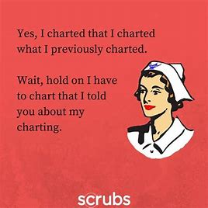
Events that May Require an Incident Report
General Incidents
Falls with or without injury
Inappropriate sex acts
Physical Intervention
Minor injuries
Physical illness requiring E.R. visit only
Hospitalizations due to planned surgery or chronic illness
Challenging behaviors
Unexpected Occurrence (a behavior not covered in the treatment plan.)

Slide 9
Immediate Notification Part 1
An “unexpected occurrence” involving a person receiving services involving unexpected death, homicide, or action by the person receiving services that requires immediate notification of the state to allow the state to address any required immediate follow-up actions including statements to the media, or removal of others from a group setting.
Immediate Notification Should be made via phone call, leave a message if the person is not available.
An Incident Report following the phone notification is required.
Contact the CMH
The CMH will contact NorthCare
NorthCare will contact MDHHS

Slide 10
Immediate Notification Part 2 & Incident Reports
MDHHS requires immediate reporting of specific incidents in four areas:
Any death that occurs as a result of suspected staff member action or inaction, or any death that is the subject of a recipient rights, licensing, or police investigation.
This report must be made to the CMH immediately or no later than 24 hours of learning of the event.
CMH report shall be submitted electronically by the PIHP within 48 hours of either the death, or the CMHSP’s receipt of notification of the death, or the CMHSP’s receipt of notification that a rights, licensing, and/or police investigation has commenced.
Relocation of the individual’s placement due to licensing suspension or revocation.
An occurrence that requires the relocation of any service site, governance, or administrative operation for more than 24 hours.
E.g., the AFC home catches fire and consumers need to spend night elsewhere
The conviction of a CMHSP or provider panel staff members for any offense related to the performance of their job duties or responsibilities which results in exclusion from participation in federal reimbursement

Slide 11
When to Write an IR
Refer to your agency policy
This training details the minimum reporting requirements for incidents
It’s not up to all staff to determine if an incident meets reporting requirements
This is the job of the Recipient Rights Officer or Quality Improvement staff
If something unusual happens, write an IR
If something causing harm happens, write an IR
If your gut makes you question if you should write an IR, write an IR

Slide 12
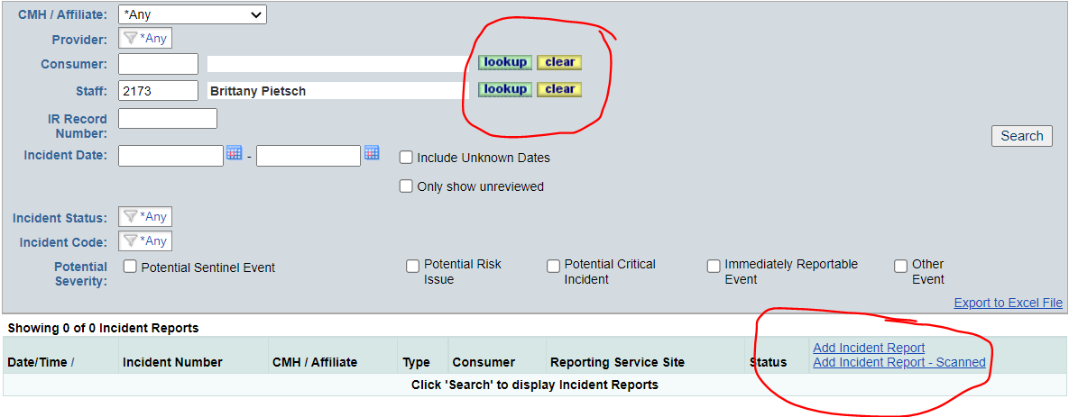
Incident Reports in ELMER
Incidents can be added by selecting the new Incident Reporting module and then selecting Incident Reports
Staff can see all previous incidents they were part of and can add a new incident report on the main page
Depending on level of access, fields may look different

Slide 13
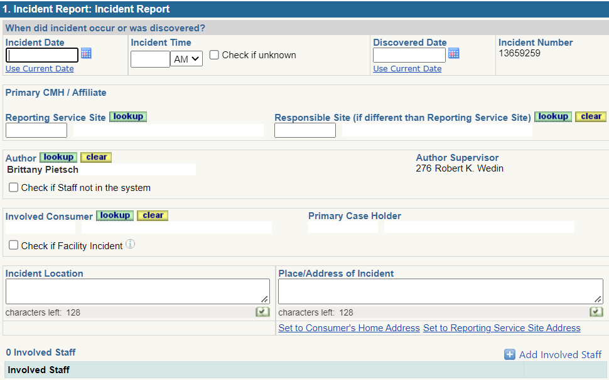
Basics of Report Writing
Write in First Person.
Use chronological order.
Use past tense.
Use active voice.
Write clearly so others can read your writing.
Use correct spelling and punctuation.
Avoid jargon and wordiness.
Write facts vs. opinions.
Choose correct words to describe the incident.
Discovered date is the date you were made aware of the incident. It may vary from the incident date
Fill out all information on this page completely. It is used in ELMER for assigning managers and other staff that need to review the report.

Slide 14
What to Write in an IR
Explain the incident in depth.
State facts and observations before and during the event. Not your opinion
Paint a picture with your words so others reading this can ascertain information that is clear and concise.
Instead of using words such as ‘angry’ describe what led you to believe they were angry. (i.e., John got up from the table, threw his cards, and made a growling noise before going to his bedroom and slamming the door after he lost the card game.)
Remember to use dignity and respect when writing about the individual and the incident.
I think John Doe wanted to get back at his room mate, because he seemed to have ill intentions when he walked up to him and grabbed him.
John Doe walked over to his roommate B.T. and forcefully grabbed him by the arm.
V.S.

Slide 15
Action Taken By Staff: Part 1
Explain all staff’s actions surrounding the incident in depth.
State facts clear and concise so others reading the IR can get a clear picture.
State what was done or not done in reaction to the incident. Refrain from using opinions.
Remember to use dignity and respect when writing about the individual and the incident.
Example: IR for John Doe
This staff was in the kitchen preparing lunch and talking with residents that were playing cards at the table. Resident B.T. won the hand and this staff congratulated him on winning. At this time his roommate John Doe walked over to B.T. and forcefully grabbed him by the arm, this staff stated “John please let go of B.T.” while moving toward the residents from the kitchen. John released B.T. before this staff reached the table. Staff checked resident B.T. for any injuries and offered comfort. Staff then proceeded to check on John who had entered his room. Staff discussed the incident with John in his room and encouraged him to use coping skills learned through his group. Staff also encouraged John to apologize to B.T. which John did, staff praised John for apologizing. At time of writing John and other housemates are laughing and playing cards.

Slide 16
Action Taken By Staff: Part 2
Any time an incident involved more than one recipient there needs to be an IR written for both persons involved. Remember:
1. Do not include recipients' names other than the person you are writing it about, only use initials.
Example:
This staff was in the kitchen preparing lunch and talking with residents that were playing cards at the table. Bobby won the hand and this staff congratulated him on winning. At this time his roommate J.D. walked over to Bobby and forcefully grabbed him by the arm, this staff prompted J.D. to let go of Bobby while moving toward the residents from the kitchen. J.D. released Bobby before this staff reached the table. Staff checked Bobby over for any injuries, (none were found) and offered comfort. J.D. apologized to Bobby and at time of writing Bobby and all other housemates are laughing and playing cards. Staff continued to monitor Bobby for any signs of pain or discomfort through the rest of the shift, none noted.

Slide 17
Corrective Measures
In this section your focus should be on what you are going to prevent or remedy this reoccurrence as well as any information from the physician regarding injury, illness or cause of death.
Staff followed the behavior plan as written. Staff will report event data changes to the behavior analyst. Staff will continue to monitor for any changes and report them to the appropriate persons for review on any changes that may need to be made to the plan. This incident will be reviewed/debriefed with staff, case manager, and behavior analyst at the next staff meeting scheduled.
Staff will continue to monitor closely for changes in behavior and intervene sooner if J.D. begins exhibiting signs that he is in pain. Staff will follow appropriate medication administration of PRN medications for pain following the doctors’ orders in order to prevent J.D. from being in pain. Staff will document medication administration and communicate it with this primary care physician as this has been more frequent since his fall and sprained ankle on LOA with his family. Staff will seek emergency medical care as necessary.
Staff administered Tylenol for pain and will continue to monitor M.M. for signs of aggression and pain. Staff removed the rug that was in the hallway that caused M.M. to stumble and blame his roommate for tripping him then punching the wall in anger. Rug will have added non-slip tape added to prevent this from happening again. Staff checked all rugs in the home to make sure that their non-stick tape was still in place. Staff found that all of the other rugs in the home are intact with non-slip surfaces.

Slide 18
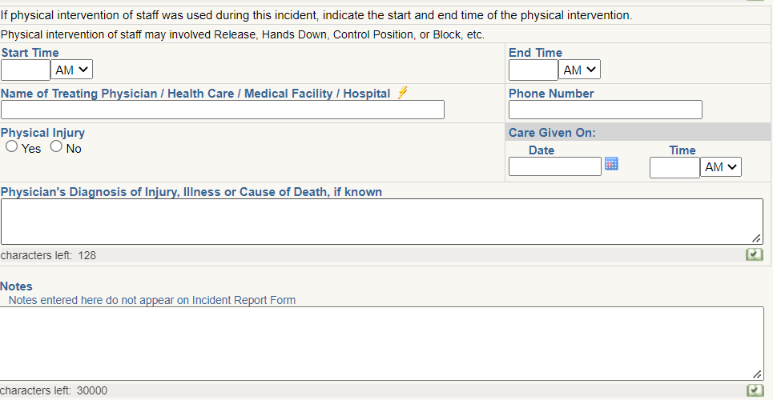
Make sure these fields are filled out completely for any follow up questions that may be needed.

Slide 19
Other Reporting
Mandated Reporters Include:
Physicians | Licensed emergency medical care providers.
Licensed master social workers. | School counselors.
Dentists. | Audiologists.
Licensed bachelor's social workers. | Teachers.
Physician's assistants. | Psychologists.
Registered social service technicians. | Law enforcement officers.
Registered dental hygienists. | Marriage and family therapists.
Social service technicians. | Members of the clergy.
Medical examiners. | Licensed professional counselors.
Persons employed in a professional capacity in any office of the Friend of the Court. | Regulated childcare providers.
Nurses. | Social workers.
School administrators. | Employees of an organization or entity that, as a result of federal funding statutes, regulations, or contracts, would be prohibited from reporting in the absence of a state mandate or court order (example: domestic violence provider).
Be sure to report to other entities as necessary, such as:
Licensing
CPS/ APS
Police
Office of Recipient Rights
We are Mandated Reporters- so be sure to document that you reported.

Slide 20
Licensing
An APS/CPS (Adult Protective Service/Child Protective Service) or law enforcement referral does not automatically get generated by a licensing complaint.
Once the consultant receives the complaint then the consultant will contact the complainant to see if the complainant has already contacted APS/CPS and law enforcement.
It is determined at that time who will file the formal complaints.
It is usually good for the complainant to file the APS/CPS and law enforcement complaints because they are the person with the firsthand knowledge of the situation.
Complainant's Licensing files are very generic and are missing much of the important information that is needed for that APS/CPS and law enforcement referral.
If the complainant is not comfortable making an APS/CPS and law enforcement complaint, then the licensing consultant will file a complaint for both.
This may take some communication between the parties to know who filed the complaint.
*Information from Andrew Silver at MDHHS

Slide 21
Police
If there is risk of imminent harm, contact police.
Per 330.1723 of the MHC: report in the following situations:
Assault (other than patient-patient assault/battery)
Criminal Sexual Abuse
Homicide
Vulnerable Adult Abuse
Child Abuse
Oral reports are to be followed by written reports within 72 hours, per Mental Health Code
*Information from Andrew Silver at MDHHS

Slide 22
Unnecessary Incident Reports
Staff injury that doesn’t involve a recipient. For example, a staff fell in the driveway shoveling. This incident should be reported to your agency following the protocols in place. CMH is not in need of these incident reports.
Consumer verbally swearing- if it is already addressed in the behavior plan or treatment plan and is not physical and not directed at anyone or impacting the resident or other residents in the home.
If there is an adverse effect on others in the home, then an incident report is required.
Remember, when in doubt write an incident report.

Slide 23
Process & Procedures after Submission
Upon completion of the IR in ELMER, it will automatically route to the employee’s supervisor who will review, document necessary section (i.e., Corrective Action to Prevent Reoccurrence, persons notified, etc.).
All incidents are reviewed by the Office of Recipient Rights. Those incidents that have the potential to meet the criteria and definitions of a sentinel event, critical event, risk event, or an immediately reportable event are then sent to the QI department for review.
All incidents are routed to the case manager of the individual for review.
At any time in this process additional reviewers can be added for example: Behavior Analyst, Nursing, & Quality Improvement.
During the process it may be identified that a further review is needed for individual or systemic questions/concerns. This can be carried out through Recipient Rights or the Quality Improvement Process.
Incidents that meet the definition for reporting to NorthCare and/or MDHHS are notified upon receipt of incident report or phone call for immediate reportable events.

Slide 24
For Supervisors

Slide 25
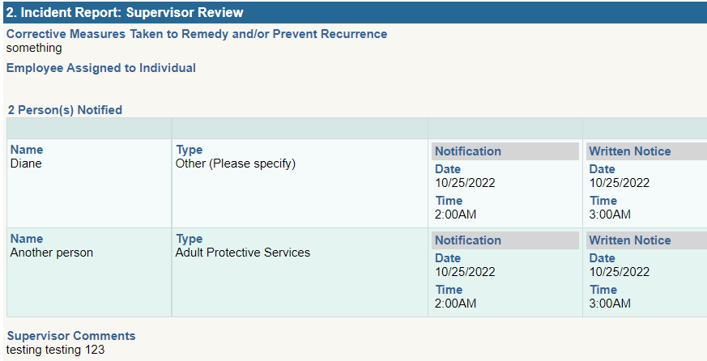
Corrective Measures
Supervisors must denote what corrective measures are necessary to prevent recurrence and should indicate any corrective measures completed by the time of writing the IR.
They can also indicate if there is an employee assigned to the consumer
And can add any other comments that aren’t related to corrective measures

Slide 26
Dance like no one is watching but
DOCUMENT
like it will be read
In court one day!
–Your Lawyer

Slide 27
Questions?
References:
ELMER Incident Reporting System
Incident Report Help Guide ELMER
MDHHS/ PIHP/ CMHSP Contract
QAPIP Practice Guideline
Critical Incident Reporting and Event Notification Requirements Practice Guide
LARA
Social Welfare Act
Mental Health Code section 330.1723
PIHP Policy
CMHSP Policy
Contact:
CMH RRO
CMH Quality Improvement
NorthCare Network
A huge thank you and credit to Stephenie Taskey for this presentation

